Slide 1
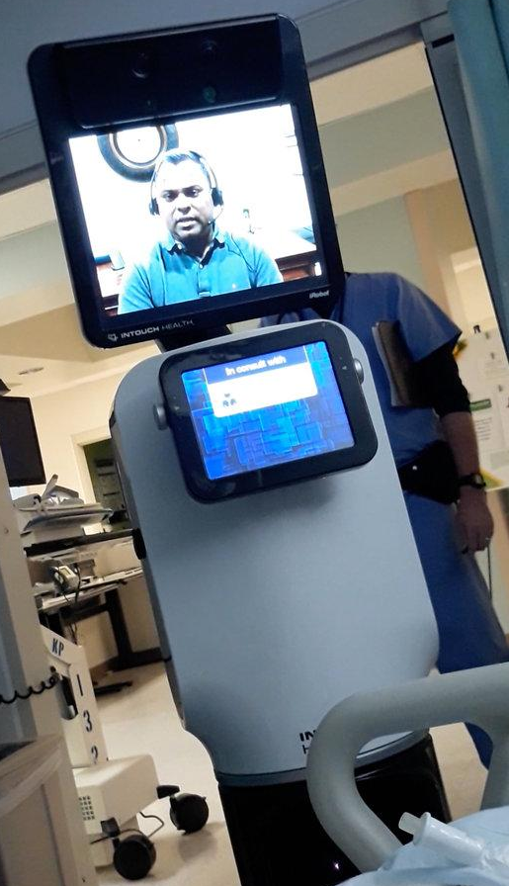
Course Wrap-Up CSE 120 Winter 2019
Instructor: Teaching Assistants:
Justin Hsia Ann Shan, Eunia Lee, Pei Lee Yap, Sam Wolfson, Travis McGaha
Doctor on Video Screen Told a Man He Was Near Death, Leaving Relatives Aghast
“[T]he family was furious that Mr. Quintana was told via video conference that he did not have long to live.
“Telemedicine is an increasingly popular tool in the health care industry. Experts said it was expanding access to care in rural areas while also allowing patients to communicate with specialists they would not ordinarily be able to reach.
“But in situations… in which doctors were communicating sensitive information about end-of-life treatment, health care providers may have to modify their approach in response to patients and their families.”
https://www.nytimes.com/2019/03/09/science/telemedicine-ethical-issues.html

Slide 2
Administrivia
Assignments:
Project code, video, and README due tonight (3/15)
Final Review: Sunday, March 17, 4-6 pm, LOW 101
Also extra office hours next week – check calendar!
Final Exam: Tuesday, March 19, 3-4:20 pm, SAV 264
Scheduled exam slot is 2:30-4:20, but exam will be 80 min
10% of your overall course grade
Two sheets of notes are allowed (letter-size paper, double-sided, handwritten)
Course Evaluation: https://uw.iasystem.org/survey/204670

Slide 3
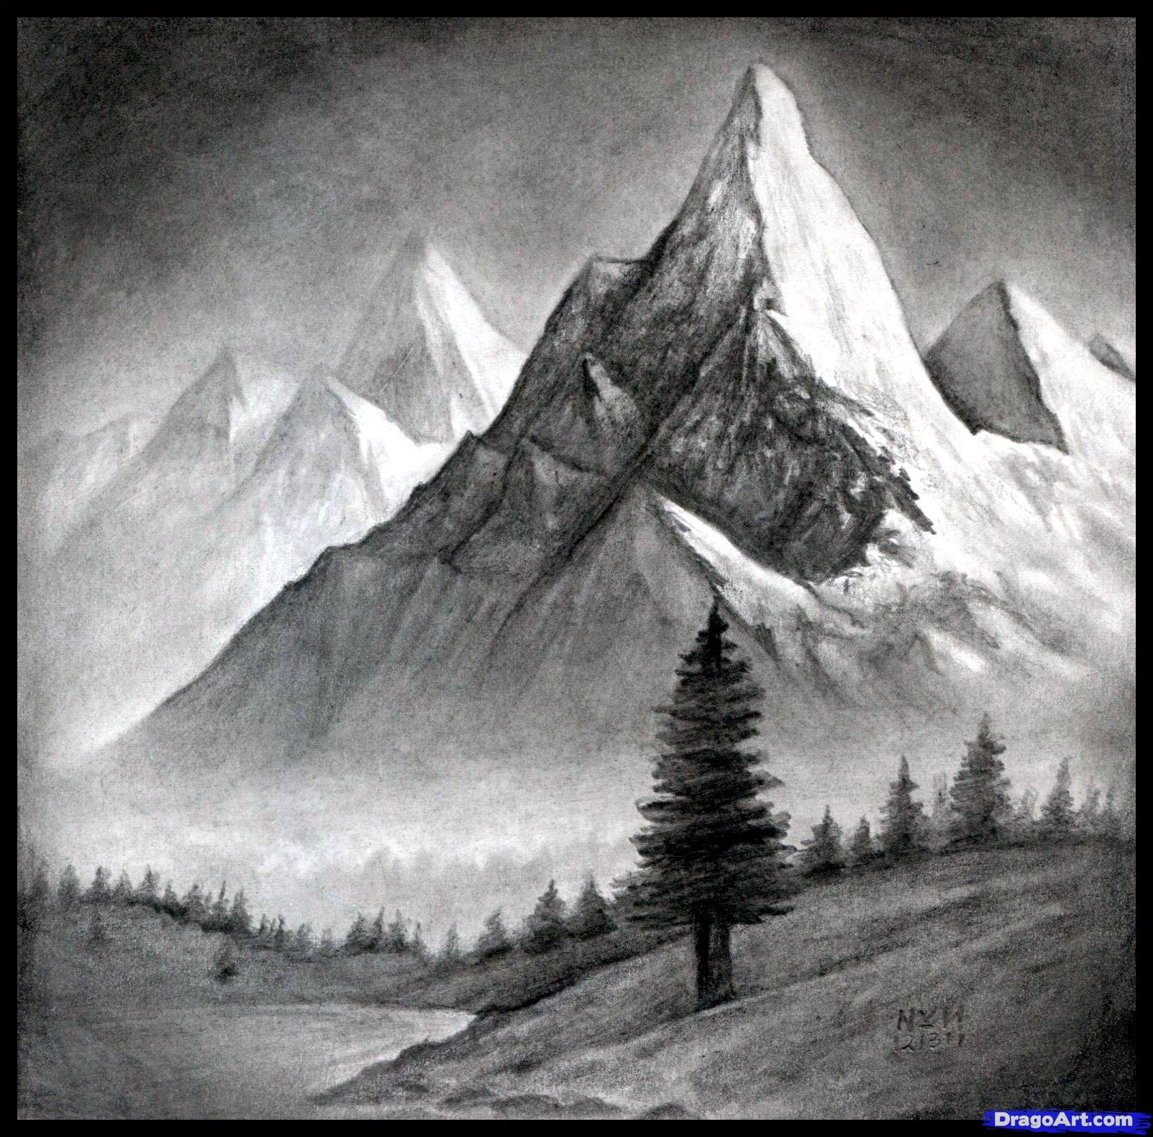
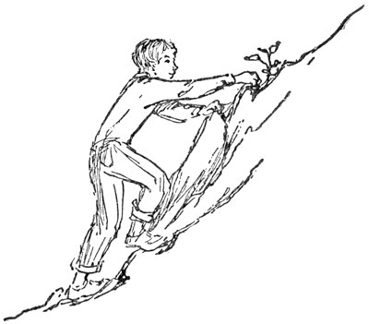
Outline
What We’ve Learned
Lecture 1 Revisited
Your Future Beyond CSE120
Source: DragoArt.com
Source: Project Gutenberg

Slide 4
Computational Thinking
It’s all about problem solving
How to attack your problem in a way that a computer can help
Most important idea: abstraction!
Detail removal and generalization help us decompose complex problems
Use bits to represent everything (i.e. digitization)
Reuse and combine building blocks (algorithms) in ways that hopefully scale well

Slide 5
Building Blocks of Algorithms
Sequencing
The application/execution of each step of an algorithm in the order given
Iteration
Repeat part of algorithm a specified number of times
Selection
Use of conditional to select which instruction to execute next
Functional Abstraction
Break larger problem into smaller, reusable parts
fill(255);
rectMode(CORNERS);
rect(-r, -r, 0, r);
ellipse(0, -r/2, r, r);
if(mousePressed) {
fill(0,0,255);
}
for(int i=20; i<400; i=i+60) {
line(i,40,i+60,80);
}

Slide 6
Programming
Learned our first programming language
Processing (Java syntax)
Iterative design cycle:
The value of a precise specification
Design, prototype, implement, and evaluate
Testing and debugging
Coding style and documentation
Proper commenting and formatting are essential for maintenance and collaboration

Slide 7
Some Big Ideas
Computers can only do a small number of things
Execute exactly what you tell it to
Computing has physical and theoretical limits
The Internet is a physical realm
Data is constantly generated, stored, and analyzed
And can be copied and distributed
Machines can “think” and “learn”?
AI & the importance of probability and training sets

Slide 8
Social Context and Impact
Impacts of computing:
Algorithms can have unintended consequences
Privacy and security (or lack thereof)
Social media influences the way we access and share information
Can improve the lives of those with disabilities (and everyone else) as well as those in developing countries
Design matters!
Must keep in mind users and user interface
What are the ethical implications and whose values are we promoting?

Slide 9
Outline
What We’ve Learned
Lecture 1 Revisited
Your Future Beyond CSE120

Slide 10
Why Study Computer Science?
Massive impact on our lives and society as a whole
Increasingly useful for all fields of study and areas of employment
Farmer – machines to help farm, drones for pesticides
Chef – analyze customer data: popular dishes, hours, etc.
Street Performers
Dancer, Gymnast – monitor and evaluate performance, diet, etc.

Slide 11
Computing in Your Future
Computing and its data are inescapable
You generate “digital footprints” all the time
Computing is a regular part of every job
Use computers and computational tools
Generate and process data
Dealing with IT people
Understanding the computation portion of projects
Our goal is to help you make sense of the “Digital Age” that we now all live in

Slide 12
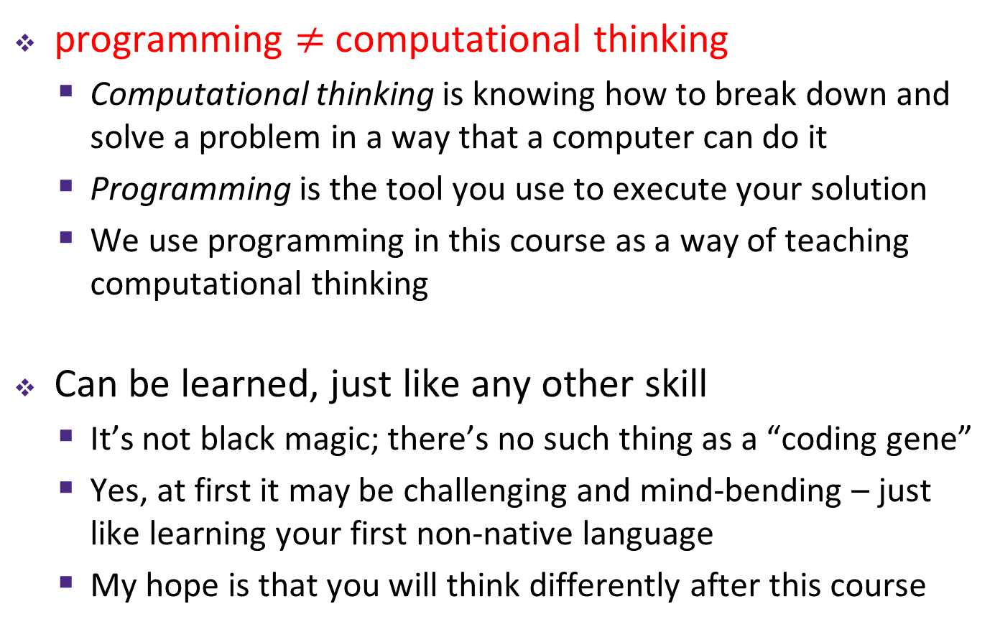
About Programming
programming $≠$ computational thinking
Computational thinking is knowing how to break down and solve a problem in a way that a computer can do it
Programming is the tool you use to execute your solution
We use programming in this course as a way of teaching computational thinking
Can be learned, just like any other skill
It’s not black magic; there’s no such thing as a “coding gene”
Yes, at first it may be challenging and mind-bending – just like learning your first non-native language
My hope is that you will think differently after this course
Notes:
Terrible stereotypes of programmers – it’s just another profession nowadays

Slide 13
Big Ideas of Computing
Exposure to a broad range of topics in computer science
Not going to dive into the details
These are the motivations & the applications for programming (the tool)
Focus on what to be aware of to navigate the digital world
Goal: become “literate” in computing
As new innovations arise, can you read about it, understand its consequences, and form your own opinion?
This course will ask you to read, discuss, and write about computing

Slide 14
Outline
What We’ve Learned
Lecture 1 Revisited
Your Future Beyond CSE120

Slide 15
Keep What You’ve Made!
You’ve all done some amazing work!
We will make a “Student Showcase” Piazza post
Make sure your files and programs are saved somewhere so you can access them later
Can re-download from Canvas submissions if necessary
Could be helpful as examples for future projects
Portfolio
Your website will remain live until you disable it or graduate
You can download a copy of your website files using Cyberduck

Slide 16
Giving Back to CSE120
Enjoyed the class? Lots of ways to help out!
Feedback: course eval, CS in Your Future, talk to me in OH or via email
Examples: Permission to show your work to future classes?
I’ll make a “Student Showcase” Piazza post later
Recommendations: CSE120 next offered in Wi20 – tell your friends!

Slide 17
Future Courses
Intro CS courses descriptions:
https://www.cs.washington.edu/academics/ugrad/overview/intro-courses
Staff recommendations and descriptions:
https://docs.google.com/presentation/d/1_9td5mZZXlueALiyDL5YjD-EsSHT8WCS8HQmVjMAzZk/edit?usp=sharing

Slide 18
More CS at UW
CSE 142 + CSE 143: Computer Programming I/II
Needed for declaring CSE major
CSE 160 + CSE 163: Data Programming I/II
Recommended to take 142 first
CSE/STAT/INFO 180: Intro to Data Science
A basic math prerequisite
CSE 154: Web Programming
Must have taken 142, 143, or 160

Slide 19
Social Implications Courses
Informatics
INFO 101: Social Networking Technologies
INFO 102: Gender and Information Technology
INFO 200: Intellectual Foundations of Informatics
INFO 270: Calling Bullshit: Data Reasoning in a Digital World
Human Centered Design & Engineering
HCDE 210: Explorations in Human Centered Design

Slide 20





No More CS at UW or Break
You are now somewhat programming-literate
Can automate tasks to make your life easier
More aware of possibilities of computing
Easier to interact with IT/CS staff at work
Figure out what will be most useful to you
Some languages specific to type of work (e.g. R, MATLAB, Ruby on Rails, SQL)
Learn on your own via the Internet:

Slide 21
Making the Most of College
Seek out experiences that lead to new experiences (i.e. that pay dividends)
Build skills, interests, relationships
Meet new people, join interesting clubs, go on adventures
Don’t go it alone – find a friend group for classes
Take advantage of educational opportunities
Research: https://www.washington.edu/undergradresearch/students/find/
Student Groups: ACM, Animation Research Labs, Husky Robotics, WOOF3D, etc.
Classes: non-major courses, P.E., languages, anything of interest
Take care of yourself!

Slide 22

Making the Most of Our Future
Computing is resurfacing our world
Now almost everyone has access to everything, always
New technology affects privacy, jobs, safety, beliefs, etc.
You now know the most important parts of how it all works!
Can bring computing to new fields/jobs/areas
Keep these considerations in mind as you use and/or build things

Slide 23
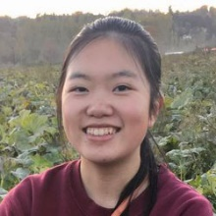
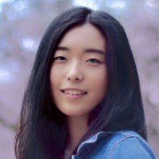
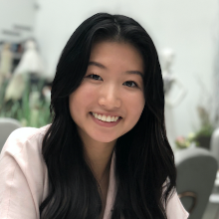

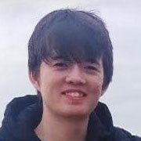
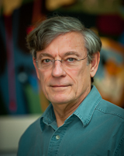

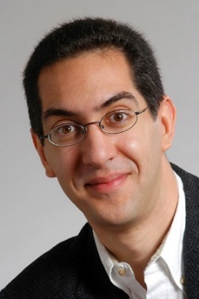
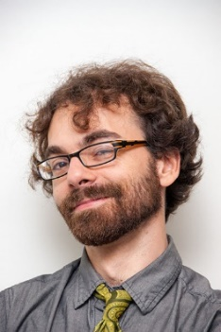
Thanks for a great quarter!
Huge thanks to your awesome TAs!
Thanks to course content creators:
Best of luck in the future!
Ann
Eunia
Pei Lee
Sam
Travis
Larry
Snyder
Susan
Evans
Dan
Garcia
Josh
Hug

Slide 24

Ask Me Anything (AMA)

